Slide 1
A delivery model for Agile API Development
February 8, 2014
Version 1.0
Chris Norton
(720) 395-7389

Slide 2
Content
What is different about API Development?
  SOA an impetus to API?
Recommend an Agile Approach
  Agile Methods
  Why Agile at VA-NPSC
Agile Approach Details
  Suggested Model
  VA-NPSC IBM Agile Development Process
  Critical Success Factors
Next Steps

Slide 3



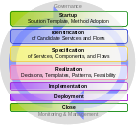
IBM SOA Assets and Models Support Multiple Types of Client Engagements
SOA Offering
Focus
Helps the C-level executives lay out a business blueprint, complete with an SOA strategy, governance, and architecture roadmap to guide the transformation of the organization and its systems to a service-oriented model using Component Based Business Models
SOA Strategy
CBM
Helps an organization assess its current state in service orientation, integration, and business process management to evaluate how it is doing and makes recommendations for corrective action, if warranted
SOA Diagnostic
SIMM
Business Process Management Enabled by SOA
Helps businesses to plan, design, model, simulate, measure,
and optimize core processes across the organization to achieve
maximum operational effectiveness in an SOA environment using SOMA
SOMA
Helps a line of business develop a robust implementation plan which includes a high-level solution architecture overview and the definition of scope in terms of process, service, and governance to successfully realize an SOA solution using SOMA
SOA Implementation Planning
SOMA
SOA Design, Development, & Integration Services
Helps an organization design and implement the targeted SOA system using SOMA
SOMA
SOA Management
Services
Helps an organization establish the management framework to sustain the SOA environment
SOMA
Notes:
SOMA supports all of these entry points.

Slide 4
Simplistic mapping of SOMA-for-AD Life-cycle to C(A)D life-cycle
Custom Development
SOMA-for-AD
Solution Startup
Solution Startup
Solution Outline
Identification
Macro Design
Scope Cycle
Specification
Model
Micro Design
Solution Management
Execute & Control Event driven Activities
Realization
Release Cycle
Assemble
Release
cycle
Build Cycle
Implementation
Impl Cycle
Deploy
Deploy
Deployment
Solution Close
Solution Close
Mapping shown to MADM (Model, Assemble, Deploy) lifecycle

Slide 5





Solution Definition Iteration key activities and duration
Inception
Solution Definition
Solution Development
Close
Iteration planning
Initiate starter team (first iteration)
Plan envisioning sessions
Schedule stakeholders for envisioning sessions
Refine shared vision
Requirements envisioning (write or elaborate stories and storyboards)
Architecture envisioning (modeling)
Consider feasibility
Release planning (x agile teams of y size with z skills, iteration timing)
Staff teams
Setup infrastructure (environments, CI, etc)
Light-weight milestone review
Communicate vision to stakeholders
Commit to iteration and release cadence
Gut feel for work vs. time
Project / Product Approved to start
Stakeholder consensus
Up to a few hours (If staff is on hand)
First iteration of a new product: Several weeks
Subsequent iterations: In parallel to solution development
Up to a few hours
Notes:
This diagram is used with permission from the forthcoming book Disciplined Agile Delivery (DAD): An Introduction by Mark Lines and Scott Ambler (tentative publication date June 2011).
The iteration rhythm is determined by the iteration length. Fixed iteration length helps drive the reliable rhythm of a project. Without this rhythm, you are constant revising, re-estimating, and reconciling ,
Cover this quickly as it overviews material in Module 7.

Slide 6
Solution Development Iteration key activities and duration
Inception
Solution Definition
Solution Development
Close
Standard” activities / practices:
Daily standup meeting / call
Story driven development
Evolutionary Architecture and Design – Add to models if useful
Architecture spike (task of a story)
Continuous Integration (automated at code check in, daily builds, keep build defect free)
Refactoring
Automated testing
Track “done” stories (e.g. burndown)
Pair programming (for complex problems)
Advanced practices:
Test-driven development (TDD)
Continuous deployment (CD)
Parallel independent testing
Iteration preplanning
Iteration planning
Iteration modeling (Design or architecture)
Iteration demo
Retrospective
Release any deployable functionality to production or advanced testing environments
Iteration start (Wednesday best)
Typical: Two weeks for simpler requirements
Four weeks for complex projects with cross-agile team integration
Potentially consumable solution
2 hours for each week of the iteration
2 hours per each week of iteration
Notes:
The iteration rhythm is determined by the iteration length. Fixed iteration length helps drive the reliable rhythm of a project. Without this rhythm, you are constant revising, re-estimating, and reconciling ,
Cover this quickly as it overviews material in Module 7.

Slide 7

Suggested Model
Task Briefed
Collect HL Requirements
Create Project Plan
Create Team Charter (Resources, Objectives)
Draft Architecture
Identify and Order Feature Releases (Project Plan)
VA-NPSC IBM Agile Development Model
The model emphasizes concurrent development of multiple features, which are organized and prioritized by the customer as feature sets. Iterations of feature development are concurrent as well.
Plan Feature Set n
Define Requirements and High Level Design
Develop Feature Set n
Iteration 1
Iteration 2
Iteration 3
Detailed Design
Build
Unit Test
Approve
Detailed Design
Build
Unit Test
Approve
Detailed Design
Build
Unit Test
Approve
Plan Feature Set n+1
Release Feature Set n
Develop Feature Set n+1
Plan Feature Set n…
System Integration Testing
User Acceptance Testing
Roll into Production
Transition to Maintenance
Release Feature Set n+1
Develop Feature Set n…
Release Feature Set n…
*An agile approach is not used for data warehouse projects by the nature of their serial development processes.
Close Out Project
Complete and Store Project Documentation
Capture Lessons Learned
Improve Development Model

Slide 8
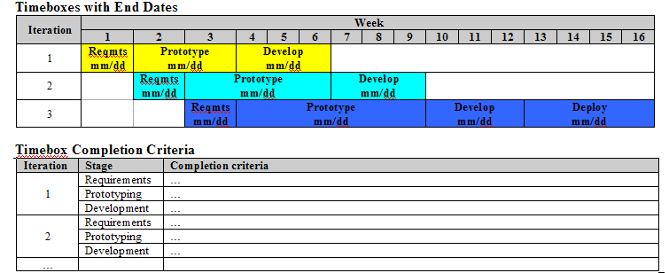
AWD Accelerator
Small Releases / Timeboxing
Do this: Specify timebox end dates and completion criteria in the Accelerator Plan
“Timebox” means what?
Fixed deadline to meet a clear objective
Traditional
Requirements fully specified and fixed
Time to develop solution is projected
Resources vary to reduce cycle time
Accelerated / Agile
Requirements specified at high-level & prioritized
Time fixed for delivery of urgent business needs
Resources fixed and managed to deliver at
estimated costs
Requirements (fixed)
Time
(fixed)
Resources
(fixed)
Time
(variable)
Resources
(variable)
Requirements (variable)
Accelerator Plan
Why do it?
Meets the true business needs for the estimated cost
Ensures deadlines are met
Provides mission focus, urgency, positive motivation
Allows progress to be regularly measured
Provides early indicator of problems
Specify date each timebox ends
Specify target criteria for completion of each timebox
Notes:
The solution is delivered in small, time-boxed releases.

Slide 9

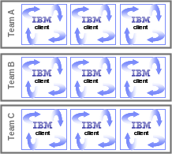


We need your help to position agile early, when we believe it complements the needs of the client
Opportunity to position agile / AWD
Scalable, Agile development cycle(s) with iterative releases, driven by the online strategy
Preceding work?
Accelerated Solution Definition
Accelerated Solution Development (First Software Release Onsite)
Subsequent Releases (Begin moving offshore)
R2
IBMi Visioning
Requirements Elaboration
Team A
client
client
client
BPM / Service Modeling
Technology Solutioning
Team B
R3
Other assessments
client
client
client
Project Mobilization
Proposals / RFPs
Team C
client
client
client
Rn
Iteration 1
Iteration 2
Iteration 3
3 Weeks
4-6 Wks
x Wks
x Wks
x Wks
Release 1
8-16 Wks
Months
* Durations can be altered based on scope, constraints and business needs
Notes:
More details behind each phase are in backup and can be pulled up based on audience and level of detail needed for the client audience.

Slide 10
At the heart of SOMA is identification, specification, realization and implementation of services, components and flows
Governance
SOMA builds on current techniques
  Domain Analysis
    Functional Areas grouping
    Variation-Oriented Analysis & Design (VOAD)
  Process Modeling
  Component-Based Development (CBD)
  Object-Oriented Analysis and Design (OOAD) / Use Case Modeling
SOMA introduces new techniques like
  Goal-Service Modeling
  Service Model Creation
  Service Litmus Test
Startup
Solution Template, Method Adoption
Identification
of Candidate Services and Flows
Specification
of Services, Components, and Flows
Realization
Decisions, Templates, Patterns, Feasibility
Implementation
Deployment
Close
Monitoring & Management

Slide 11









SOA enables enterprise-wide, cross-channel re-use of business-aligned IT capabilities
Participants
Interaction
Processes
Services
Components
Data
Media
Views
Business
Services
Party
Contract
Holder
Package
Existing Assets
Custom
Customer
New Business – Form based
Process
Services
External
Forms
Financial
Professional
Get Producer ID
Product
Annuitant
Browser
Separate Accounts
Party
Accept E Signature
Service
Free Look Timer
Product
Contract
Financial
Professional
Email
Receipt of Application
Check Duration
Sales
Channel Partners
Contract
Activities
Phone PDA
Remittance
Other Services
Regulator
Activities
Other
Views
Commissions
Text Message
Exchanges
Atomic
Services
Commissions
Service Provider
Electronic Business
Gateway
Other
Stores
Composite
Services
Other
Components
Other Annuity
Providers
……….
Rules
Integration (Application Bus)
Navigation
Technical
Services
Process
Vendor / Partner
Systems
Security
Services
Session
Management
Event
Management
Connection
Management
Product
Security

Slide 12

Current VA-NPSC IBM Development Model
Task briefed
Identify task lead
Lead creates Task Understanding document
Task Understanding validated
Business processes documented
Requirements and design specifications documented
Web and database development activities
Unit Test and application delivery
System integration and user acceptance testing
Develop user guides and training material
Deploy system to production
 | VA-NPSC |  | IBM

Slide 13





What are the core elements that SOA brings together?
Coming together under
Service Oriented Architecture
Skills - assistance, and best practices
Applications
Industry know-how and best practices linked to business
Flexible, robust infrastructure that reuses existing IT assets
Notes:
What’s are some core elements that SOA brings together?
Starting at the bottom, you start with a flexible, robust infrastructure. It’s essential to keep in mind that this is NOT a replacement for your existing infrastructure or other existing investments. The SOA infrastructure is more of an overlay to your existing IT assets.
Next comes access to the right know-how and best practices that are linked to the business.
On top of that, the applications that you have installed in your business that perform the functions you use.
And at the top, to build these skills takes the right, assistance and best practices

Slide 14
Why IBM for SOA?
IBM understands service orientation and your business
Expertise in aligning business and IT processes
SOA consultants, architects and IT specialists
Dozens of SOA-enabled business solutions
Unique intellectual property and methods
Skills
Thriving ecosystem of partners (ISVs, SIs, Resellers)
100+ partners in SOA community
Partners
Extensive Industry experience and best practices
Over 1000 customers worldwide
Know-how & best practices
Unmatched breadth and depth of products
Over $1B/yr invested in SOA
IBM leads over 50 standards bodies
Over 300 SOA-related patents
Infrastructure
Notes:
Why would you choose IBM for SOA? The biggest reason is that IBM understands service orientation and understands your business. IBM has a heritage in providing computing solutions. IBM has a ‘footprint’ across entire enterprise so let’s use the same categories we discussed on the previous slide
Again, let’s start with infrastructure. IBM has unmatched breadth and depth of software products for SOA. We invest over $1B per year in SOA, This is the kind of investment and leadership that businesses can take advantage of when they choose IBM. IBM not only supports standards but brings true leadership to standards bodies. We lead over 50 of them. We also have over 300 SOA-related patents.
Moving up, IBM has extensive industry experience and best practice with over a thousand SOA customers all over the world in a wide variety of industries. While others may talk about their theories of SOA, IBM has the real-world experience to make it real today.
IBM has a thriving ecosystem of partners. Independent software vendors, systems integrators and resellers are gravitating to IBM as the leader in SOA. We have over a hundred SOA partners and the list keeps growing.
This leads to the top layer and our expertise in aligning business and IT processes. We have extensive soa consultants, architects, and IT specialists, dozens of soa-enabled business solutions and a unique portfolio of intellectual property and methods. And what we learn through this expertise gets fed back into the software products as well.

Slide 15
SOA Reference Model - Supported by IBM Software
BUILD
RUN
MANAGE
Business Services
Exploiting the SOA foundation to deliver a Component Business Model
Tivoli Composite Application Mgr for SOA
Rational RequisitePro
Business Innovation & Optimization Services
WebSphere Business Modeler
Facilitates better decision-making with real-time business information
WebSphere Business Monitor
Tivoli CAM for WebSphere
WebSphere Integration Developer
Integrate People
Integrate Processes
Integrate Information
Development
Services
IBM Workplace
Content Manager
Tivoli CAM for Response Time Tracking
Enables collaboration between people, processes & information
WebSphere Process Server
IT Service
Management
WebSphere Portal
Orchestrate and automate business processes
Manages diverse data and content in a unified manner
WebSphere Information Integrator
Rational Software Architect
Tivoli Enterprise Console
WebSphere ESB
WebSphere Message Broker
Enterprise Service Bus (ESB)
Rational Application Developer
Tivoli Service Level Advisor
Integrated environment for design and creation of solution assets
Partner Services
Business App Services
Access Services
Manage and secure services, applications &
resources
Rational Tester
Family
Tivoli Configuration Manager
Connect with trading partners
Build on a robust, scaleable, and secure services environment
Facilitates interactions with existing information and application assets
WebSphere Partner Gateway
WebSphere Application Server
WebSphere Adapters
Rational
ClearCase & ClearQuest
Infrastructure Services
Database : DB2 / Informix
Tivoli Access Manager
Optimizes throughput, availability and performance
WebSphere Extended Deployment
Tivoli Federated Identity Manager
Notes:
**Main point: The SOA reference Model is a vendor-neutral way of looking at and planning the set of services that go into building an SOA.
The SOA reference architecture is a way of looking at the set of services that go into building an SOA. This architecture is not unique to IBM; these are things that you need to consider when approaching SOA regardless of what products and services are used. These capabilities can be implemented on a build-as-you-go basis allowing capabilities and project level solutions to be easily added as new requirements are addressed over time. You can see that these services organized along the same lifecycle we’ve discussed. On the left in is Development Services which is model and assemble, in the middle are the elements of the deployment run-time environment you use and on the right is management. The backbone of the reference architecture is the enterprise service bus which facilitates communication between services. The reference architecture is a great tool for laying out roadmaps for pursuing SOA. Regardless of what kind of project you’re undertaking, it makes sense to lay it out on a reference architecture to see how the various services you’re designing are going to interact with each other
Additional detail:
The SOA Reference Model outlines the key capabilities that are required for comprehensive, enterprise wide SOA solutions. These capabilities can be implemented on a build-as-you-go basis allowing capabilities and project level solutions to be easily added as new requirements are addressed over time.
Tools are an essential component of any comprehensive integration architecture. The SOA Architecture includes both Development Services which are used to implement custom artifacts that leverage the infrastructure capabilities, and Business Innovation & Optimization Services which are used to monitor and manage the runtime implementations at both the IT and business process levels.
At the core of the SOA Reference Architecture is the Enterprise Service Bus. This delivers all of the inter-connectivity capabilities required to leverage the services implemented across the entire architecture. Transport services, event services, and mediation services are all provided through the ESB.
The SOA Reference Architecture also contains a set of services that are oriented toward the integration of people, processes, and information:
Interaction Services provide the capabilities required to deliver IT functions and data to end users, meeting the end-user's specific usage preferences.
Process Services provide the control services required to manage the flow and interactions of multiple services in ways that implement business processes.
Information Services provide the capabilities required to federate, replicate, and transform data sources that may be implemented in a variety of ways.
Many of the services in an SOA are provided through existing applications; others are provided in newly implemented components; and others are provided through external connections to third party systems.
Existing enterprise applications and enterprise data are accessible from the ESB through a set of Access Services that provide the bridging capabilities between legacy applications, pre-packaged applications, enterprise data stores and the ESB.
The SOA Reference Architecture also contains a set of Partner Services that provide the document, protocol, and partner management capabilities required for business processes that involve inter-actions with outside partners and suppliers.
Business Application Services provide runtime services required for new application components to be included in the integrated system.
Underlying all these capabilities of the SOA Reference Architecture is a set of Infrastructure Services which are used to optimize throughput, availability and performance.
IT Services Management Services include capabilities that relate to scale and performance, for example edge services, clustering services, and virtualization capabilities allow efficient use of computing resources based on load patterns.
The SOA Reference Architecture is a complete and comprehensive architecture that covers all the integration needs of an enterprise. Its services are well integrated and are delivered in a modular way, allowing SOA implementations to start at a small project level. As each additional project is addressed, new functions can be easily added, incrementally enhancing the scope of integration across the enterprise.
Background:
The IBM SOA Foundation delivers the capabilities you need to adopt SOA through a comprehensive architecture. These capabilities can be implemented on a build-as-you-go basis, and yet, because of the architecture and its service orientation, capabilities and project level solutions can be easily added as new requirements are addressed over time.
The SOA Reference Architecture shows the key capabilities that are required for comprehensive, enterprise wide SOA solutions.
Development Services are an essential component of any comprehensive integration architecture. The SOA Architecture includes development tools, used to implement custom artifacts that leverage the infrastructure capabilities, and business performance management tools, used to monitor and manage the runtime implementations at both the IT and business process levels. Development tools allow people to efficiently complete specific tasks and create specific output based on their skills, their expertise, and their role within the enterprise. Business Analysts who analyze business process requirements need modeling tools that allow business processes to be charted and simulated. Software Architects need tool perspectives that allow them to model data, functional flows, system interactions, etc. Integration Specialists require capabilities that allow them to configure specific inter-connections in the integration solution. Programmers need tools that allow them to develop new business logic with little concern for the underlying platform. Yet, while it is important for each person to have a specific set of tool functions based on their role in the enterprise, the tooling environment must provide a framework that promotes joint development, asset management and deep collaboration among all these people. A common repository and functions common across all the developer perspectives (e.g. version control functions, project management functions, etc) are provided in the SOA Reference Architecture through a unified development platform.
The Business Innovation & Optimization Services incorporate monitoring capabilities that aggregate operational and process metrics in order to efficiently manage systems and processes. Managing these systems requires a set of capabilities that span the needs of IT operations professionals and business analysts who manage the business operations of the enterprise. These capabilities are delivered through a set of comprehensive services that collect and present both IT and process-level data, allowing business dashboards, administrative dashboards, and other IT level displays to be used to manage system resources and business processes. Through these displays and services, it is possible for LOB and IT personnel to collaborate to determine, for example, what business process paths may not be performing at maximum efficiency, the impact of system problems on specific processes, or the relationship of system performance to business process performance. This collaboration allows IT personnel and assets to be tied more directly to the business success of the enterprise than they traditionally have been.
One key feature of the SOA Reference Architecture is the linkage between the Development and the Business Innovation & Optimization Services. The ability to deliver runtime data and statistics into the development environment allows analyses to be completed that drive iterative process re-engineering through a continuous business process improvement cycle.
At the core of the SOA Reference Architecture is the Enterprise Service Bus. This architectural construct delivers all the inter-connectivity capabilities required to leverage and use services implemented across the entire architecture. Transport services, event services, and mediation services are all provided through the ESB. Transport services provide the fundamental connection layer; event services allow the system to respond to specific stimuli that are part of a business process; and mediation services allow loose-coupling between interacting services in the system. The ESB is a key factor in enabling the service orientation of the SOA Reference Architecture to be leveraged in implementing service oriented solutions and can be implemented today to meet the quality of service requirements of any integration solution.
The SOA Reference Architecture also contains a set of services that are oriented toward the integration of people, processes, and information. These services control the flow of interactions and data among people and automated application services in ways appropriate to the realization of a business process:
- Interaction Services provide the capabilities required to deliver IT functions and data to end users, meeting the end-user's specific usage preferences.
- Process Services provide the control services required to manage the flow and interactions of multiple services in ways that implement business processes.
- Information Services provide the capabilities required to federate, replicate, and transform data sources that may be implemented in a variety of ways.
Automated application services, implementations of business logic in automated systems, are a critical part of any integration architecture or solution. Many of these services are provided through existing applications; others are provided in newly implemented components; and others are provided through external connections to third party systems. Existing enterprise applications and enterprise data are accessible from the ESB through a set of access services. These Access Services provide the bridging capabilities between legacy applications, pre-packaged applications, enterprise data stores (including relational, hierarchical and nontraditional, unstructured sources such as XML and Text), etc and the ESB. Using a consistent approach, these access services expose the data and functions of the existing enterprise applications, allowing them to be fully re-used and incorporated into functional flows that represent business processes. Existing enterprise applications and data leverage the Business Application and Data Services of their operating environments such as CICS, IMS, DB2, etc. As these applications and data implementations evolve to become more flexible participants in business processes, enhanced capabilities of their underlying operating environments, for example support of emerging standards, can be fully utilized.
The SOA Reference Architecture also contains a set of Business Application Services that provide runtime services required for new application components to be included in the integrated system. These application components provide new business logic required to adapt existing business processes to meet changing competitive and customer demands of the enterprise. Design and implementation of new business logic components for integration enables them to be fully re-useable, allowing them to participate in new and updated business processes over time. The Business Application Services include functions important to the traditional programmer for building maintainable, flexible, and re-useable business logic components.
In many enterprise scenarios, business processes involve inter-actions with outside partners and suppliers. Integrating the systems of the partners and suppliers with those of the enterprise improves efficiency of the overall value chain. Partner Services provide the document, protocol, and partner management services required for efficient implementation of business-to-business processes and inter-actions.
Underlying all these capabilities of the SOA Reference Architecture is a set of Infrastructure Services which provide security, directory, IT system management, and virtualization functions. The security and directory services include functions involving authentication and authorizations required for implementing, for example, single sign-on capabilities across a distributed and heterogeneous system.
IT Services Management Services include functions that relate to scale and performance, for example edge services and clustering services, and the virtualization capabilities allow efficient use of computing resources based on load patterns, etc. The ability to leverage grids and grid computing are also included in infrastructural services.
While many of the Infrastructure and IT Service Management services perform functions tied directly to hardware or system implementations, others provide functions that interact directly with integration services provided in other elements of the architecture through the ESB. These interactions typically involve services related to security, directory, and I/T operational systems management.
The SOA Reference Architecture is a complete and comprehensive architecture that covers all the integration needs of an enterprise. Its services are well integrated and are delivered in a modular way, allowing SOA implementations to start at a small project level. As each additional project is addressed, new functions can be easily added, incrementally enhancing the scope of integration across the enterprise. In addition to supporting SOA strategies and solutions, the architecture itself is designed using principles of service orientation and function isolation.
*** We overlay the key products that support the Model*********
Please see http://w3.ibm.com/news/w3news/top_stories/2005/09/igsswg_soa.html for additional information

Slide 16
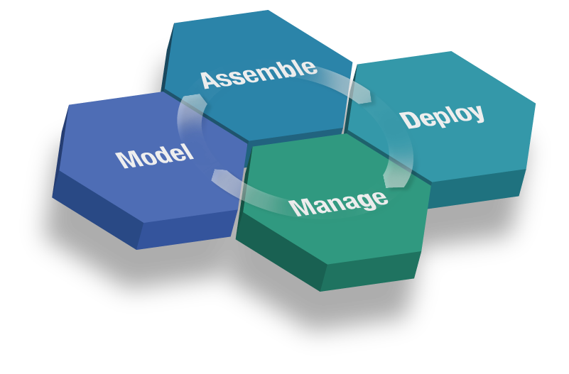
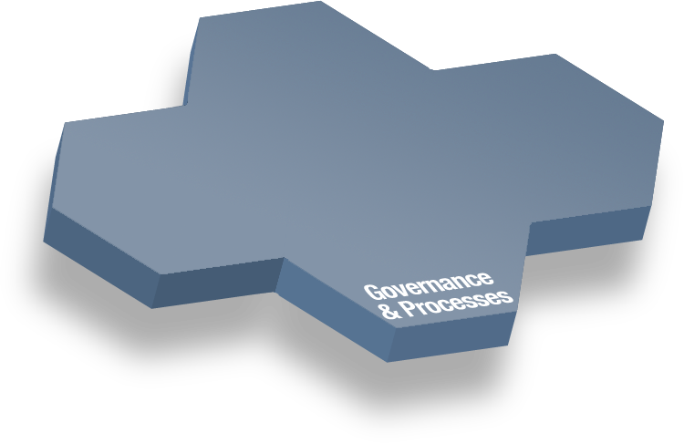
SOA Foundation
Part of a broader portfolio to meet your every need
WebSphere Integration Developer
Rational Application Developer
Process:
WebSphere Process Server
WebSphere ESB & Message Broker
WebSphere Partner Gateway & Adapters
People:
WebSphere Portal
WebSphere Everyplace Deployment
Workplace Collaboration Services
Information:
WebSphere Information Integrator
Application Infrastructure:
WebSphere Application Server & XD
WebSphere Business Modeler
Rational Software Architect
WebSphere Business Monitor
Tivoli Composite Application Manager
Tivoli Identity & Access Manager
Notes:
The SOA Foundation is built with software that was carefully selected from a broader software portfolio. These are the specific, targeted software products that support each stage of the SOA lifecycle. They are interoperable and fully modular so you can select just what you need today with the comfort that it will work well with other additions you may want to make in the future.

Slide 17
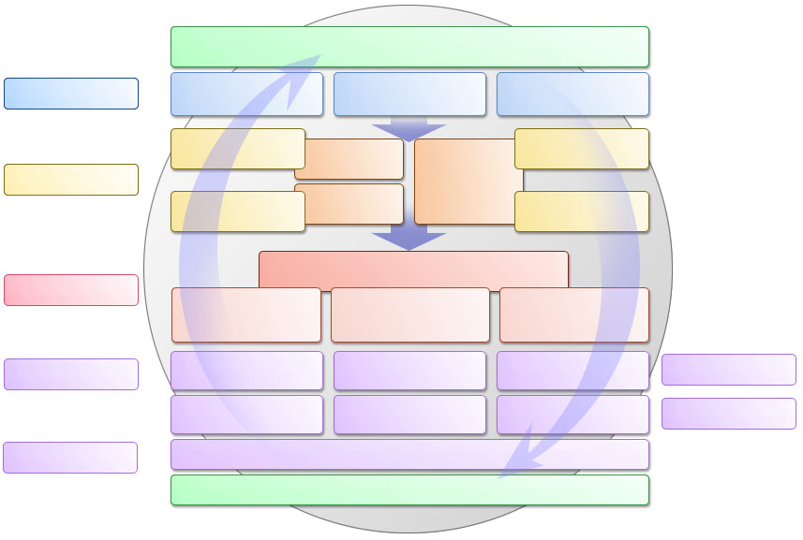
IBM uses Service Oriented Modeling and Architecture (SOMA) Method Guidance for Architecture, Design and Delivery of SOA Engagements
Governance
Identification
of candidate services and flows, existing assets
Startup
Selection of Solution Templates, Method Adoption
Identification
Domain
Decomposition
Goal-Service
Modeling
Existing Asset
Analysis
Specification
of services to be exposed, flows, and components (for realization of services)
Component Flow
Specification
Subsystem
Analysis
Service
Specification
Service Flow
Specification
Specification
Information
Specification
Component
Specification
Message & Event
Specification
Realization
Capture realization decisions (concurrently with first two phases), explore feasibility of realization scenarios, instantiate SOA Reference Architecture
Realization
Realization Decisions
Solution Template
& Pattern
Selection and Instantiation
Technical Feasibility Exploration
Detail SOA Solution
Reference Architecture
Implementation
Construction
Generation
Assembly Integration
Build/Assembly
Implementation
Implement service components and services
Unit Testing
Integration Testing
User Acceptance
Testing
Testing
Deployment
Deployment (Packaging/Provisioning)
Deployment
Package and provision
Close
Monitoring & Management
Governance
Notes:
Each SOMA phase is subdivided into individual activities. Each phase is carried out by applying one or more complementary techniques.
Iterative and Incremental techniques are used mainly to reduce risks on a project.

Slide 18
SOMA defines What we do and How we do it
What we do ?
How we do it?
Governance
Identification
of candidate services and flows, leverageable existing assets
Input from: Business Analysis & Existing Asstes
Domain Decomposition
Goal-Service Modeling
Existing Asset Analysis
Specification
of services to be exposed, flows, and components (for realization of functionality)
Component Flow Specification
Subsystem Analysis
Service Flow Specification
Service Specification
Information Specification
Component Specification
Message & Event Specification
Realization
captures realization decisions (concurrently with first two phases), selects solution templates, conducts TFE and details SOA Solution Ref. Arch.
Realization Decisions
Solution Template & Pattern Selection
Technical Feasibility Exploration
Detail SOA Solution Reference Architecture
Solution Template & Pattern Instantiation
Construction Generation
Assembly Integration
Implementation
incl. construction/ generation, assembly, testing, deployment, monitoring and management
Unit Testing
Integration Testing
User Acceptance Testing
Deployment (Packaging/Provisioning)
Monitoring & Management
Notes:
Each SOMA phase is subdivided into individual activities. Each phase is carried out by applying one or more complementary techniques.

Slide 19


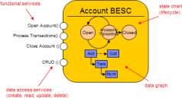



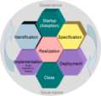
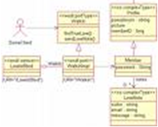

ADIT – Application Development Implementation Toolkit
Assets are key component of IBM Global Delivery
ADIT packages together several key SOA/J2EE development assets that automate a significant portion of the project lifecycle for custom applications.
AD Automation Transforms (ADAT) is a Model Driven Development (MDD) code generation tool.
Process Modeling
Object Modeling
Java Code
WBM
BELA
CTE Runtime Services
AD Automation Transforms (ADAT)
Core ADAT
Process
Models
R4SC Code
Domain Object
Java project
Service Mediator
Service Contract
Service Result
Automatic
CRUD Services
+
Web project
Access Policies
ADA
Automatic
SCA project
EJB project
ADAT UI
Service Modeling
Portal Factory
JSF
RSA
SOMA-ME
Automatic
Service
Models
R4SC Design Patterns
Object
Models
Entry Points

Slide 20
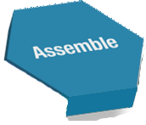
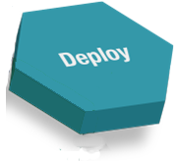
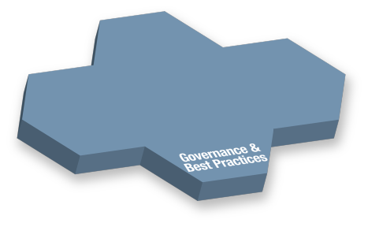
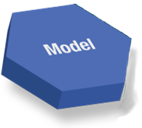
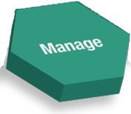
SOA governance effectively manages the service lifecycle by governing key processes across the entire lifecycle
Assemble solution
Design the architecture
Develop the service
Test the functionally
Deploy solution
Deploy to
infrastructure
Test the system
Model business processes
Identify business domain
Assign ownership
Allocate funding
Model the service
- Identify the service
- Specify the service
- Realize the service
Manage / operate system
Manage access
Monitor the service
Manage versions
Manage retirement
Effective SOA governance must:
Help define guiding decisions around these processes
Properly enforce these guiding decisions
Communicate these guiding decisions effectively
Evolve these guiding decisions with changing needs
Ensure that the perspective of both service providers
and consumers are properly met
Notes:
Important Points On This Slide:
Slide shows what we mean by effective service lifecycle management and identifies key processes to be governed across the lifecycle.
Incremental adoption is the best approach for SOA governance (similar to SOA). It is critical for customers to try and phase these processes with each iteration of governance.
Customers may identify additional processes that they need to manage across the service lifecycle. This list is not exhaustive, but these should be seen as a core set of processes that need to be managed at a minimum to have effective service lifecycle management.
Effective SOA governance needs to occur across the entire service lifecycle and transcend all phases of that lifecycle
Effective SOA governance is more than just defining the guiding decisions (stds and best practices) around these key processes across the services lifecycle. It is also about enforcing, communicating, and evolving these guiding decisions. One of its greatest tasks is doing all of this while still making it easy on those you are governing to do the right thing and making it hard for them to do the wrong thing.
Speaker Notes:
This slide is animated, so I have included <click> points to help the speaker
When we defined SOA governance, we stressed the importance of effective service lifecycle mgmt. This slide shows what we mean by effective service lifecycle mgmt. We will walk through the entire service lifecycle and identify the key processes that need to be governed for a service lifecycle to be managed effectively. Note that this is not an exhaustive list of processes that need to be governed and any one customer may have additional processes based on their given situation. At the center of the slide, we see IBM’s notion of the 4 main phases of the service lifecycle – model, assemble, deploy, and manage.
The key processes for the model phase consider critical steps for initial planning of the service and also modeling techniques to properly identify and prioritize service candidates. These processes are:
Identify Business Domains – Understanding how your organization can be broken down into logical domains that will be the foundation for service ownership. Examples of domains are customer care, purchasing, manufacturing, etc.
Assign Ownership – This is where it is decided who is going to own the particular service. For example, you may have 3 different business units in an organization that need a customer information service and are willing to develop one, how are you going to decide who the appropriate owner should be, so that there is no redundancy in functionality, but all parties interests are well served.
Allocate Funding – How are you going to pay for the service? Usual funding is a responsibility of ownership, but some companies may have tiered funding models where funding is phased at different points in the lifecycle by different parties. Also, how are you going to analyze a service, so it can be determined that the service should be funded in the first place? Also, many times there will be initial funding to model the service and then another phase of funding after the service has been properly identified with appropriate granularity to determine if the owner should move forward to development.
Model the Service – modeling the service is broken down in three main sub-processes that reflect our SOMA methodology – Identify, Specify, and Realize. Identify is identifying a pool of potential service candidates, specifying is choosing the highest priority candidate service from that pool of possible candidates and realizing is high level design of the service such as functionality, interfaces, etc.
<click> The next processes are the assemble processes. These processes are:
Design the Architecture – This process takes the inputs from the model and is more low level design touching all of the architectural points required to develop the service – standards that need to be followed best practices, etc..
Develop the Service – This process describes how the service is actually developed. Could even go into development environments used and coding standards that are required.
Functionally Test – This process describes the functional testing that needs to occur, could be both unit and integration testing to ensure the business functionality is accurate.
<Click> The next processes are the Deploy processes. These processes are:
Deploy to Infrastructure – This describes the deployment standards and best practices that need to be followed to ensure that the deployment of the service to a shared infrastructure is a success. It can touch what needs to be done for the ESB, what needs to be stored in the registry and repository.
System Test – this process describes what needs to be done to realize non-functional requirements. Also how to assess the incremental load a service would place on shared components, whether those components are an ESB or other services.
<Click> The next processes are for the Manage phase. These processes are:
Manage Access – this process will describe how access to the service will be appropriately managed. This access management will have to be understood for both consumers internal to the company and partners that may reside externally. Such questions like will we use a service gateway? What traffic will have to be routed through that gateway and which can be managed directly using the ESB? How are we going to setup access to make management of user accounts simple to procure but also simple to delete in case misuse occurs.
Monitor the Service – This process will describe how to effectively monitor a service so that problems can be quickly fixed in a reactive manner and so that many may be prevented in a proactive manner? To monitor such services, what quality of service criteria need to be monitored (ie – availability, accessibility, reliability, etc.)
Manage Versions – This process is probably the most difficult processes to govern given that some consumers will want the latest and greatest all the time, while some consumers will never want to migrate from an old version of a service. These expectations need to be managed for all consumers and special care needs to be taken to define services that are backwards compatible with older versions to minimize disruption.
Manage Retirement – This process is also very tricky and needs special consideration. Retirement of a service means that consumers need some other alternative and that migration is usually a costly process. Processes need to be defined around the appropriate criteria to understand when a service should be retired.
This completes are core processes across the service lifecycle that need to be governed for effective service lifecycle. Note that given your particular company, you may decide to add additional processes – this is not an exhaustive list of all possible processes. Another important point is that if you are just starting your SOA governance initiative, you should not try to tackle all of these processes at once. Instead, you should try to phase them making sure that the initial processes that are being tackled will be the most instrumental in fulfilling the initial goals of the company’s SOA initiative.
<Click> Now, we see our bottom layer of governance. As you can tell from the diagram, governance serves as the foundation for all phases of the service lifecycle and needs to transcend the entire lifecycle to be effective. The bottom box lists the important responsibilities of governance. When most people think of governance they think of defining the guiding decisions (or standards and best practices) around the processes that we have just identified across the lifecycle. However, to be effective, governance needs to do much more than just define these processes, it needs to understand how to enforce these processes, how to communicate them to ensure everyone is on the same page, and how to ensure that they evolve with the changing needs of the business and / or architecture. The biggest role governance needs to satisfy in realizing these processes across the services lifecycle is how do you make it easy for those that you are governing to do the right thing. Effective governance is governance that builds schools not prisons and makes it easy for people to do the right thing.

Slide 21
The legacy to SOA solution lifecycle (This needs to focus on how do you deliver API deriving from this SOA solution life-cycle)
Model(1) – Outline Solution
Model(2) - Design
Assemble
Deploy
10
Define Solution Scope
Define
Solution
Design
1
16
17
Strategy
6
Test
Solution
Perform
Training
Design Services
1
11
Develop
Solution
18
Setup
Production
System
7
Identify Solution Alternatives
Design Components
2
Analyze Existing Assets
3
13
12
Document
Solution
Unit Test
Solutions
19
Deploy
Solution
20
Deploy
Support
14
Finalize Solution
Integrate
Solutions
8
21
Run
Solution
Refine Business Requirements
4
15
Plan
Deployment
Plan Development
Outline Solution
9
5
Manage

Slide 22
Getting from business architecture to SOA based service implementation through SOMA
Solution Startup
Identification
Specification
Realization
Implementation
Deployment
Initiate
Project
Management
Activities
Conduct
Goal-Service
Modeling
Specify
Services
Refine &
Detail
Components
Construct,
Generate &
Assemble
Services
Deploy
Services
1
4
8
12
16
19
Business Domains & Processes In Scope
Composition
Flows
Operations
Messages
NFRs
Select
Solution
Templates and
Patterns
Analyze
Sub-systems
Establish
Realization
Decisions
Execute
Unit Test
Execute
User Acceptance
Test
2
Service Model
9
13
17
20
Perform
Domain
Decomposition
Analyze
Existing
Assets
5
6
Specify
Components
Conduct
Method
Adoption
Workshop
10
3
Perform
Technical
Feasibility
Exploration
Execute
Integration
& System Test
Process
Functional Areas
Information
Rules
Variations
14
18
Service Model
Customize Delivery Method
Re-factor
& Rationalize
Services
(Service Exposure)
7
Re-factor
& Rationalize
Services
(Service Exposure)
Detail SOA
Solution
Stack Layers
11
15
Service Litmus Test
Tailored Delivery Process
Goal Service Model
Functional Area Description
Business Function System Matrix
Service Model (Identification Level)
Service Model,
Service Component Model
Service Model
Service Component
Model
Architectural
Decisions
Code, XSD,
WSDL, BPEL
Operational Model
Outputs

Slide 23
Getting from business architecture to SOA based service implementation through SOMA
Solution Startup
Identification
Specification
Realization
Implementation
Deployment
Initiate
Project
Management
Activities
Conduct
Goal-Service
Modeling
Specify
Services
Refine &
Detail
Components
Construct,
Generate &
Assemble
Services
Deploy
Services
1
4
8
12
16
19
Business Domains & Processes In Scope
Composition
Flows
Operations
Messages
NFRs
Select
Solution
Templates and
Patterns
Analyze
Sub-systems
Establish
Realization
Decisions
Execute
Unit Test
Execute
User Acceptance
Test
2
Service Model
9
13
17
20
Perform
Domain
Decomposition
Analyze
Existing
Assets
5
6
Specify
Components
Conduct
Method
Adoption
Workshop
10
3
Perform
Technical
Feasibility
Exploration
Execute
Integration
& System Test
Process
Functional Areas
Information
Rules
Variations
14
18
Service Model
Customize Delivery Method
Re-factor
& Rationalize
Services
(Service Exposure)
7
Re-factor
& Rationalize
Services
(Service Exposure)
Detail SOA
Solution
Stack Layers
11
15
Service Litmus Test
Tailored Delivery Process
Goal Service Model
Functional Area Description
Business Function System Matrix
Service Model (Identification Level)
Service Model,
Service Component Model
Service Model
Service Component
Model
Architectural
Decisions
Code, XSD,
WSDL, BPEL
Operational Model
Outputs

Slide 24

Rational Solution Framework
Manual Testing
Manual Tester
Change Request
Management
Requirements
Management
Test
Management
Auto Funct Test
ClearQuest
RequisitePro
ClearQuest
Functional Tester
Business Modeling
Visual Modeling
Data Modeling
Auto Perf Test
Business Modeler
Software Modeler
Data Architect
Performance Tester
Software Architect
Service Integration
IDE
Integration
Developer
Application Developer
Build Management
BuildForge
Configuration Management
Deployment
ClearCase
Provisioning Manager
Project & Portfolio Management / Governance
Portfolio Manager, Method Composer & SoDA
Notes:
Initial setup

Slide 25
Business Case
Requirements are dynamic throughout development
  Although a majority of the requirements are documented and signed off prior to development, many unknown requirements are discovered during and after development
Current model perpetuates “over the wall” hand offs during development
  IBM performs unit testing and delivers the application to VA-NPSC for testing
  Bugs are generally not identified and fixed until the system is in production
Development activities have disparate timelines
  When an application is required to interact with other data sets or use Business Objects for reporting, time is spent negotiating development in environments outside VA-NPSC control
VA-NPSC customers need to see business value sooner
  “Time to market” is critical for VA-NPSC customers because of mission requirements
  Traditional development approaches are time consuming because of the serial nature of activities

Slide 26
Opportunities
Leverage agile development concepts to:
  Deliver working components of applications sooner
  Adapt to rapidly changing circumstances
  Minimize rework and ensure quality before going to production
Leverage close proximity of resources
  Small development teams facilitate effective communication resulting in increased productivity
  Ability to have a stakeholder with decision making authority as a team member
  Customer is usually onsite, but daily conference calls and DataXchanges can occur
Improve the existing infrastructure and tool sets
  Support an agile approach
  Accelerate delivery to a production environment that supports scalability
  Use a test environment that mirrors the production environment
  Work with the appropriate tools for the job (e.g. LoadRunner)
Notes:
An agile approach manages change
Features are developed and released in the order set by the customer through active stakeholder participation
Joint teams develop and test
VA-NPSC and IBM resources are in close proximity, which enables highly collaborative teams to avoid hard hand-offs and maximize stakeholder participation
Agile projects decompose the design into manageable releases
Complex projects can be broken into smaller, more manageable projects
VA-NPSC customers can receive functioning software sooner

Slide 27
Agile Methods
All agile methods have similar characteristics
  Active stakeholder participation
  Small, highly collaborative teams
  Iterative build and test development cycles
  Incremental deliveries
  Empowered teams to adapt to circumstances
  Frequent short meetings
  Focus on rapid delivery of value to the customer
Agile is a flexible development approach used to provide value to the customer quicker in dynamic environments. Agile does not mean quicker development.
Extreme Programming (XP)
Based on values of simplicity, communication, feedback, courage, and respect
Start with simple solution, add complexity through refactoring
Frequent feedback through unit, integration, and acceptance testing
4 dev. Phases: coding, testing, listening, designing
SCRUM
Small teams of 6-8 people
“Backlog” defined requirements that will be addressed in each Sprint
Daily 15 min.Scrum meeting to discuss work for the day
Divide projects into 30 day “Sprints”
Review conducted at end of each Sprint to review progress and revise backlog
Crystal
Frequent delivery
Reflective improvement
Close communication w/personal safety
Access to expert users
Automated testing
Frequent integration
Configuration management
Dynamic Systems Development Method (DSDM)
3 primary phases: Pre-Project, Project Life-Cycle , Post-Project
Project Life-Cycle consists of Feasibility Study, Business Study, Functional Model Iteration, Design/Build Iteration, and Implementation
Agile Unified Process
Simplified version of RUP – reduced number of disciplines
Consists of 4 RUP phases (Inception, Elaboration, Construction, Transition)
Adaptive
Repeating Speculate, Collaborate, Learn cycles
Provides for continuous learning and adaptation to changing project state
Feature Driven Dev.
More value on design then the “code is the design”
Model-driven
Develop feature list
Plan, Design, Build by Feature
IBM Accelerated Solutions Delivery (ASD) Services, “ASD Model and Practice Overview for Agile@IBM”, 2006
Aguanno, Kevin Managing Agile Projects, First Edition, 2004

Slide 28
Legend
Process Direction
Processes and Sub-Processes
Tasks
Yes
Binary Decision Point
No
%
Multiple Decision Path
%
%
Input (I), Output (O), and Go-To (G)
Process End

Slide 29
VA-NPSC IBM Agile Development Process 1.0
Court Order
G1
Do stakeholders agree with goals?
External Process
Define project goals to satisfy input drivers
Validate project goals with stakeholders
Yes
Define project requirements to meet project goals
Politically Sensitive Issue
No
Return to “Define project goals”
Media Report
G1
Congressional Inquiry
Is system support required?
Does a capability exist for required support?
Process Ends
Yes
Determine required support
Yes
Plan using the existing system
FEMA Initiative
No
No
Continues w/o system support
Request System Support
Delivered System
Will Agile Model be used?
Support Request
Perform Agile System Development
Evaluate Support Request
Yes
No
Updated Documentation
Continues w/ traditional approach
E.g., data warehouse projects will use a traditional approach.
1.1

Slide 30
Perform Agile System Development Process 1.1
Support Request
Validate Task Understanding
Validated Task Understanding
High Level Requirements
Plan the Project
Project Charter
Collect High Level Requirements
1.1.1
1.1.2
Approved Requirements & HL Design
Approved Feature Set Release
Manage Scope Process 1.1.6
Plan Feature Set n
Develop Feature Set n
Approved Feature Set
Release Feature Set n
1.1.3
1.1.4
1.1.5
Approved Requirements & HL Design
Approved Feature Set Release
The Plan, Develop, and Release processes will repeat as necessary based upon the number of feature sets identified in the Project Plan
Plan Feature Set n+1
Develop Feature Set n+1
Approved Feature Set
Release Feature Set n+1
1.1.3
1.1.4
1.1.5
Finalize requirements document
Finalize technical documentation
Document lessons learned
Improve development processes
Delivered System
Updated Documentation

Slide 31
Validate Task Understanding Process 1.1.1
The task understanding can include a delivery estimate if the timeline from a similar project with identical WBS is known. If not, a more thorough schedule estimate is developed during the Plan the Project Process 1.1.2 and validated with the participating stakeholder.
G2
Support Request
Has a similar project been worked by the developer?
Meet with stakeholders to receive task
Document understanding of task
Yes
Include rough delivery estimate in Task Understanding
No
Wait until Planning to provide schedule
Do customers disagree with stated task understanding?
Return to “Document understanding”
Deliver Task Understanding document to customer
Yes
Meet with stakeholders to clarify understanding
G2
No
Validated Task Understanding
Version and store Task Understanding

Slide 32
Plan the Project Process 1.1.2
High Level Requirements
Resource the Project Team
Assigned Resources
Draft the system architecture
Define project objectives
Decompose Requirements into Features
1.1.2.1
Determine LOE for each feature
Organize features by sets
Prioritize feature sets with stakeholder
Create project plan
All information from the planning process becomes a part of the Project Charter (i.e. Project Plan, Resources, Risk Mitigation, Request Forms, Objectives)
Define risk mitigation
Define team roles & responsibilities
Complete Project Charter
Complete and send Sys Admin support request
Will system integrate with other data sets?
Do all team members agree with Project Charter?
Project Charter
Yes
Complete and send ODS support request
Yes
All team members sign Charter
No
No
Refine Charter sections until satisfied

Slide 33
Resource the Project Team Process 1.1.2.1
Will development be in JSP?
Are IBM JSP developers available?
Database Mgt resources are assigned by FEMA
IBM resources are assigned by IBM
High Level Requirements
Review requirements for needed resources
Yes
Review IBM available resources
Yes
Assign IBM JSP developer
No
No
Assign Database Mgt ASP developer
Will Business Objects be used?
Will Database Mgt develop the database?
Yes
Assign BO developer
Yes
Assign Database Mgt Db developer
No
No
Assign IBM Db developer
Assigned Resources
Assign Process Design Tester to team
Assign stakeholder POC to team

Slide 34
Plan Feature Set n Process 1.1.3
G3
Project Charter
Conduct requirements interviews
Document results
Create high level design of features
Validate requirements & design
Does stakeholder approve?
Approved Requirements & HL Design
Yes
Stakeholder signs off on feature set requirements & HL design
No
Return to “Validate requirements & design”
Capture stakeholder feedback
Update requirements
Update design
G3

Slide 35
Develop Feature Set n Process 1.1.4
Approved Requirements & HL Design
Does stakeholder approve?
Develop detailed application design
Validate detailed design w/ stakeholder
Yes
Develop database schema
Develop web application
No
Develop Business Objects Universe
Update design with stakeholder
G4
Does application pass unit test?
Develop Business Objects Reports
Perform unit testing
Yes
Validate feature w/ stakeholder
No
Return to “Perform unit testing”
This process will occur for the development of each feature. Many features may make up a feature set. The development of these features may be concurrent depending upon resources and dependencies.
Update necessary application code
G4
Does stakeholder approve?
Approved Feature Set
Design
Build
Test
Approve
Yes
Stakeholder signs off on developed feature
Design
Build
Test
Approve
No
Design
Build
Test
Return to “Perform unit testing”
Design
Build
Update application to reflect feedback
G4

Slide 36
Release Feature Set n Process 1.1.5
G5
Is integration testing required?
Pass integration testing?
Approved Feature Set
Create test plan
Yes
Perform system integration tests
Yes
No
No
Return to “Perform integration tests”
Troubleshoot & update code as necessary
G5
Pass user acceptance testing?
Perform user acceptance testing
Yes
No
Return to “Perform integration tests”
Update necessary application code
Update documentation
G5
Does stakeholder approve?
Approved Feature Set Release
Validate feature set is ready for release
Yes
Stakeholder signs off on feature set release
No
Return to “Perform user acceptance testing”
Update application to reflect feedback
G5

Slide 37
Manage Scope Process 1.1.6
Change Request
Stop the project
Review change request
Prepare schedule estimate
Update Task Understanding to reflect change
Does stakeholder agree with schedule and Task Understanding?
Updated Project Charter
?%
Update Project Charter
Return to project execution
Yes
No
?%
Can the change be mitigated with stakeholders?
Meet to discuss mitigation of change
?%
Document agreed upon change
Yes
No
?%
Escalate to senior management
External mitigation process

Slide 38

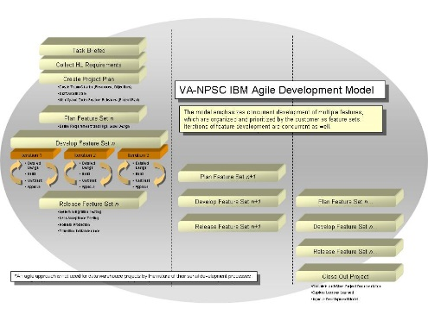
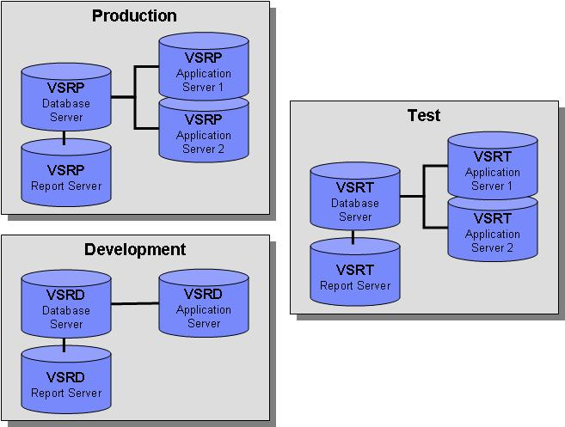
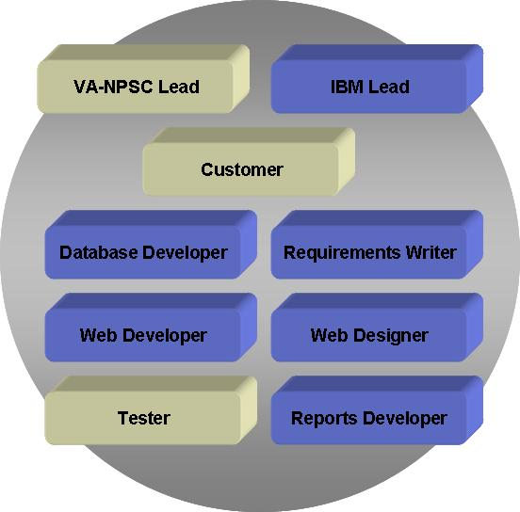
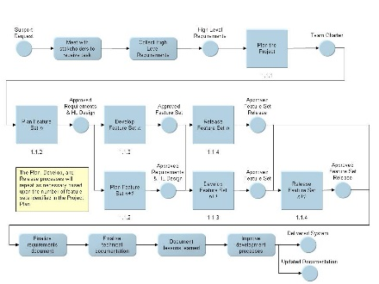
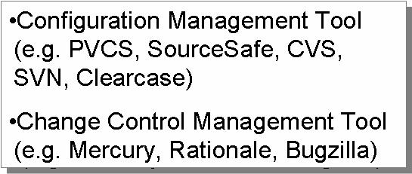
Critical Success Factors
An agile approach will be successful if…
The right people with the right skills are available and stakeholders are actively involved
Adherence to a documented and repeatable agile process
The appropriate infrastructure and tools are available
People
Process
Technology
Frequent Meetings & Effective Communication
Agreed Upon Model
Recommended Architecture
Empowered Joint Teams with Active Stakeholder Participation
Repeatable Development Process
Required Tools
Cockburn, Alistar Agile Software Development, 2004
Ambler, S.w. Agile Modeling: Best Practices for the Unified Process and Extreme Programming, 2002
Aguanno, Kevin Managing Agile Projects, First Edition, 2004
Notes:
Effective communication
Small collaborative teams with the ability to exchange ideas quickly
Effective channels of communication for dispersed teams
Efficient and effective documentation methods with stakeholders
Active stakeholder participation
Prioritize requirements
Provide input into the system as its built
Approve each iteration prior to release of a feature
Provide decision making authority
Empowered teams
Ability to organize efficiently for a particular project
Flexible execution of tasks
Enabled by the right architecture and tools to complete the project successfully
Frequent, short meetings
Ensure the entire team is moving in the same direction
Keep all stakeholders informed of progress, risks or issues
Technology Process
Cold (off-line) backup – All application and database services are shut down and the directories that contain the database and application are copied to backup media.
Hot (on-line) backup – All application and database services remain up. Each tablespace is placed in hot backup mode (begin backup), copied to backup media and then taken out of hot backup mode (end backup). A control file is also copied.
Archive log mode – When the database is placed in hot backup mode, all changes to database are recorded in archive logs which are generated sequentially.
Certification – Disaster recovery exercise where the existing backups are used to restore the application and database.
Recommended backup procedure:
Production database placed in archive mode.
Cold backups once a week.
Hot backups every night (three times a week at minimum).
Move archive logs to backup media.
Backup Certification at least once every three months.
Recovery procedure documented.
Retention of archive logs for two months.
Off site storage of backup media.

Slide 39
Next Steps
Brief development model to VA-NPSC
Incorporate VA-NPSC feedback and guidance
Identify pilot project to use development model

